Slide 1
Computer Organization
TOPIC 2.0 – Computer organization
TOPIC 2
2.1.5: Secondary Memory

Slide 2

REVIEW REVIEW REVIEW REVIEW REVIEW REVIEW
THE WARM-UP QUESTION
What are the differences between DRAM and SRAM?

Slide 3
REVIEW REVIEW REVIEW REVIEW REVIEW REVIEW
THE WARM-UP ANSWER
DRAM: Slower, more affordable, used for system primary memory
SRAM: Faster, more expensive, used for system cache

Slide 4
TOPIC 2.1.5 – SECONDARY MEMORY
NON-VOLATILE MEMORY
As discussed last time, RAM is volatile memory
This means that if the computer loses power for whatever reason, the data will be lost
RAM capacity is also generally limited, meaning it well eventually fill up
We also discussed ROM, a form of non-volatile memory.
ROM cannot be changed after it has been written once, so it won’t work as a form of long term storage.

Slide 5
TOPIC 2.1.5 – SECONDARY MEMORY
Secondary memory
Secondary memory fills these roles
Secondary Memory is relatively slow memory that may be written to, like RAM, but is also non-volatile (like ROM)
Due to this, secondary memory is often referred to as persistent storage
Secondary memory is also much larger in capacity to hold a wide variety of data

Slide 6
TOPIC 2.1.5 – SECONDARY MEMORY
Secondary memory
Without secondary memory, ROM would be the only persistent storage, which would strongly limit what we can do with our computers
This might work for a calculator, but it means you could never store phone numbers, addresses, or the programs you write on your own computer.

Slide 7
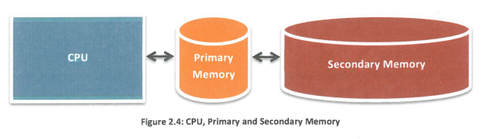
TOPIC 2.1.5 – SECONDARY MEMORY
Diagram

Slide 8
TOPIC 2.1.5 – SECONDARY MEMORY
Secondary memory
Secondary memory is connected to primary memory, but not directly connected to the CPU
The CPU will ask primary memory for data or instructions, and if what the CPU wants isn’t in primary memory, it will then check secondary memory
The data obtained from secondary memory is then loaded into primary memory, which the CPU can then access

Slide 9
TOPIC 2.1.5 – SECONDARY MEMORY
VIRTUAL MEMORY
When the primary memory fills up, any necessary information
(currently running programs, open files, etc)
will be booted back into secondary memory in a special chunk that imitates primary memory
This process is called Virtual Memory

Slide 10
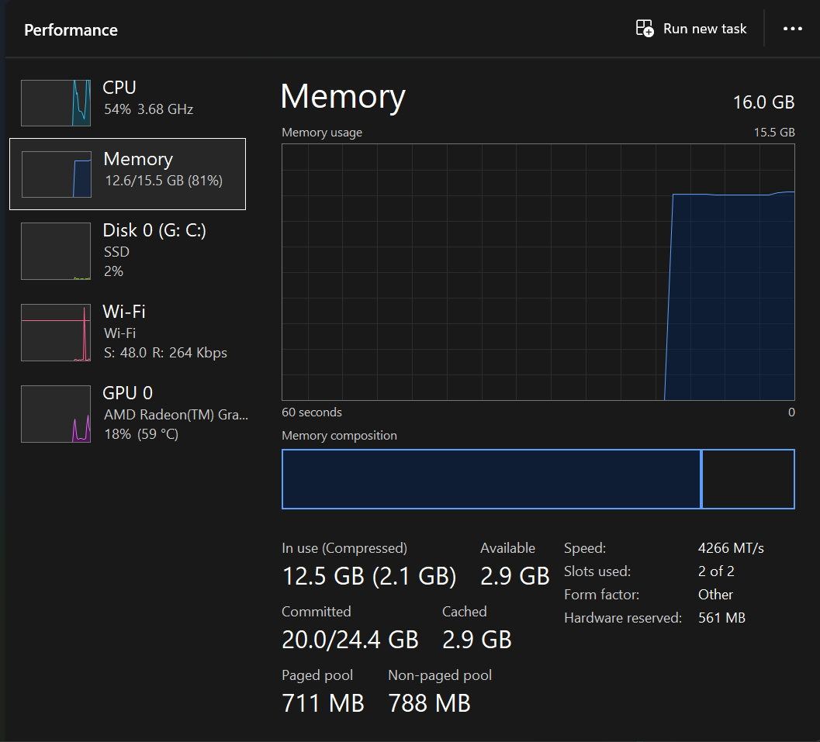
TOPIC 2.1.5 – SECONDARY MEMORY
VIRTUAL MEMORY
The use of virtual memory makes secondary memory a requirement for pretty much every computer

Slide 11
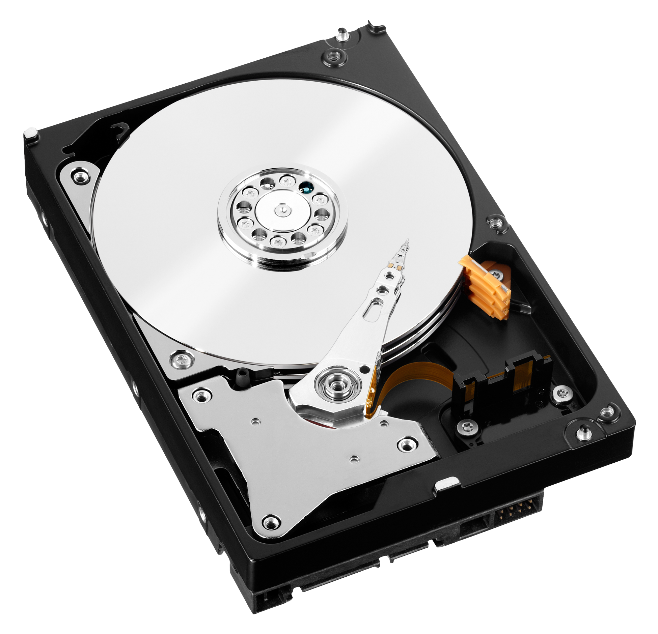
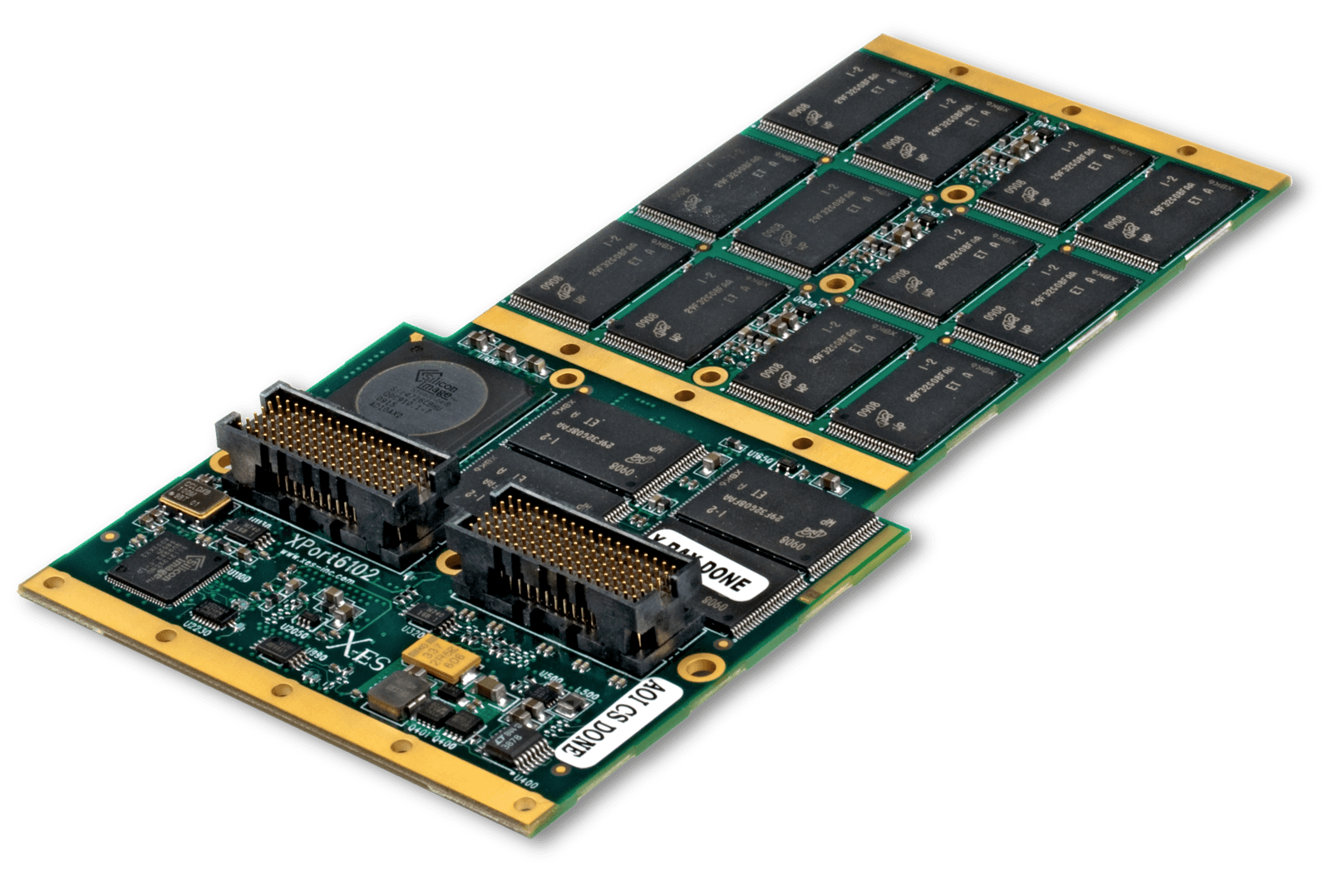
TOPIC 2.1.5 – SECONDARY MEMORY
SECONDARY MEMORY MEDIA
Storage devices as secondary media
Hard Disk Drive (HDD) – magnetic disc that spins around to access bits of data
Solid State Drive (SSD) – much faster alternative to HDD, but less durable

Slide 12
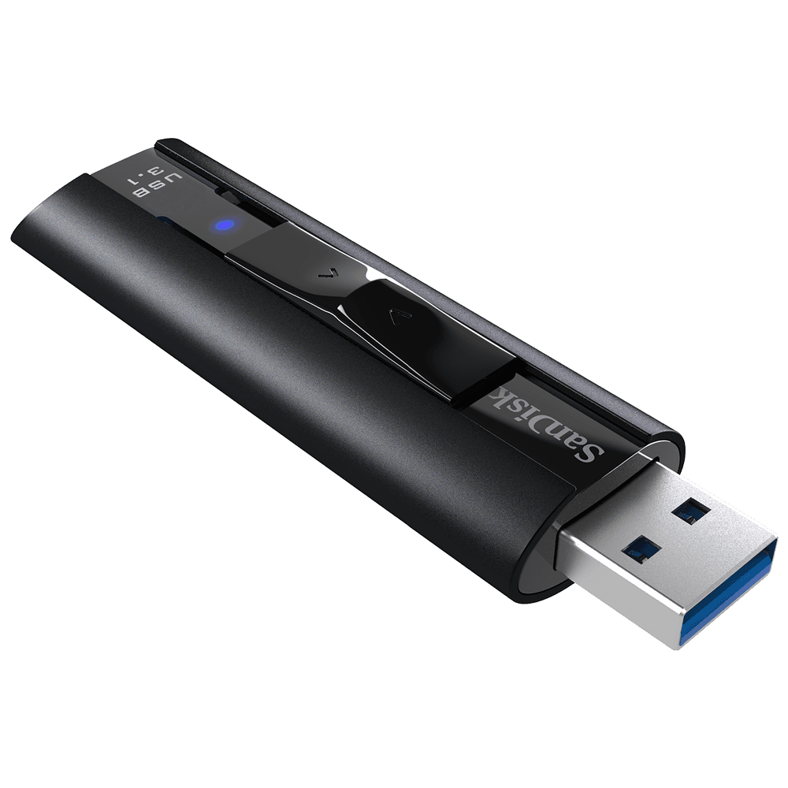
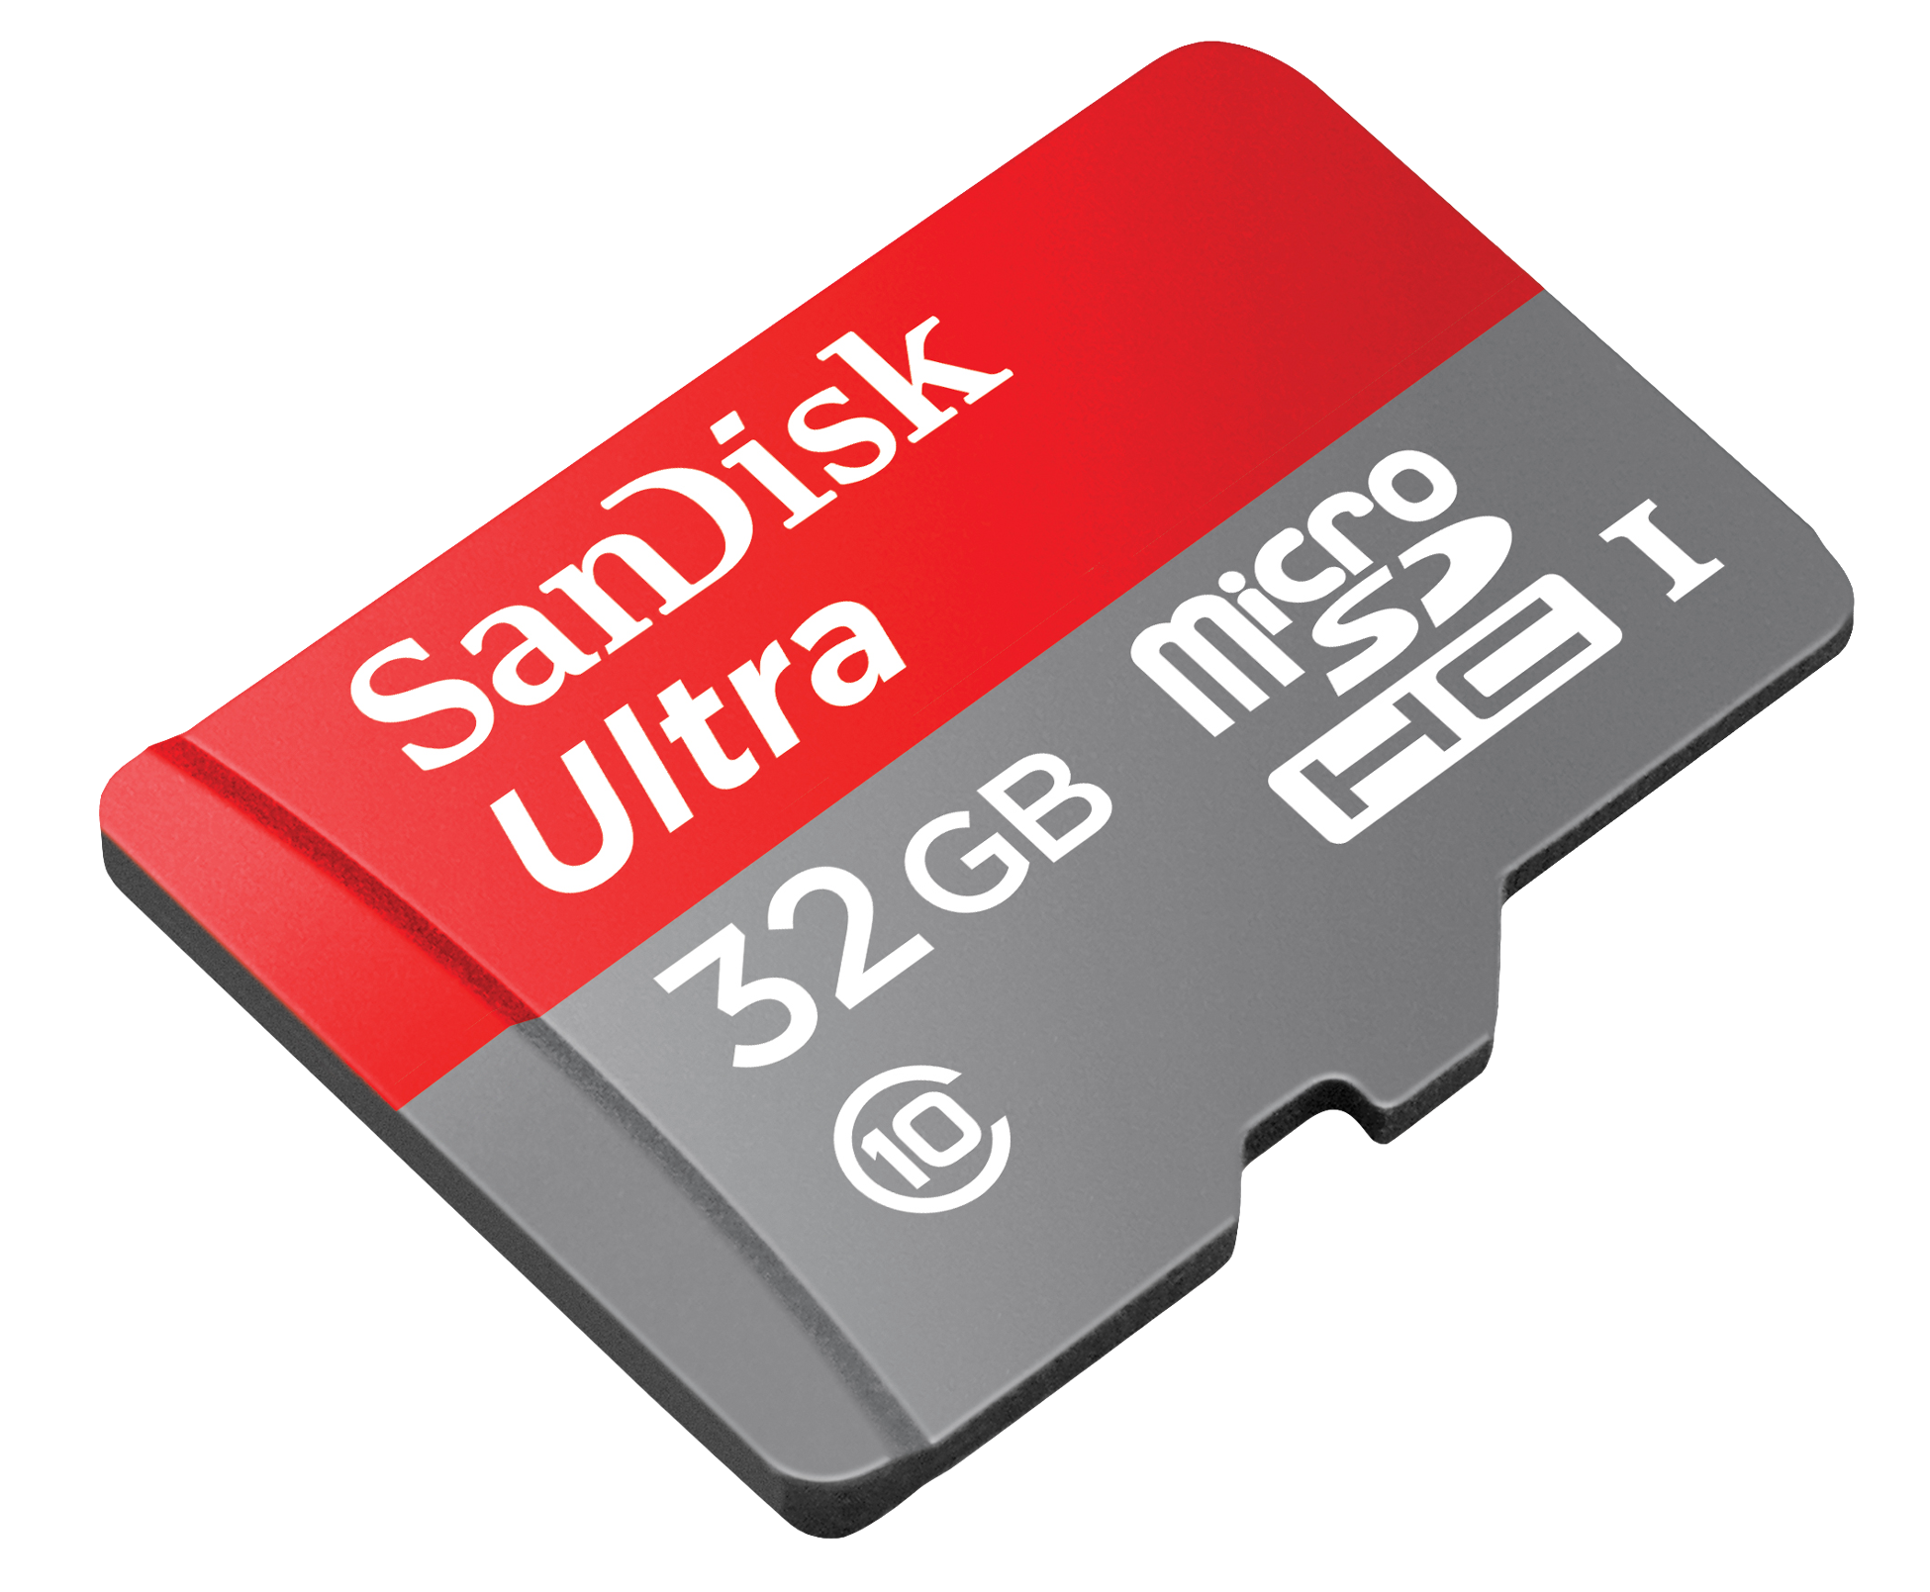
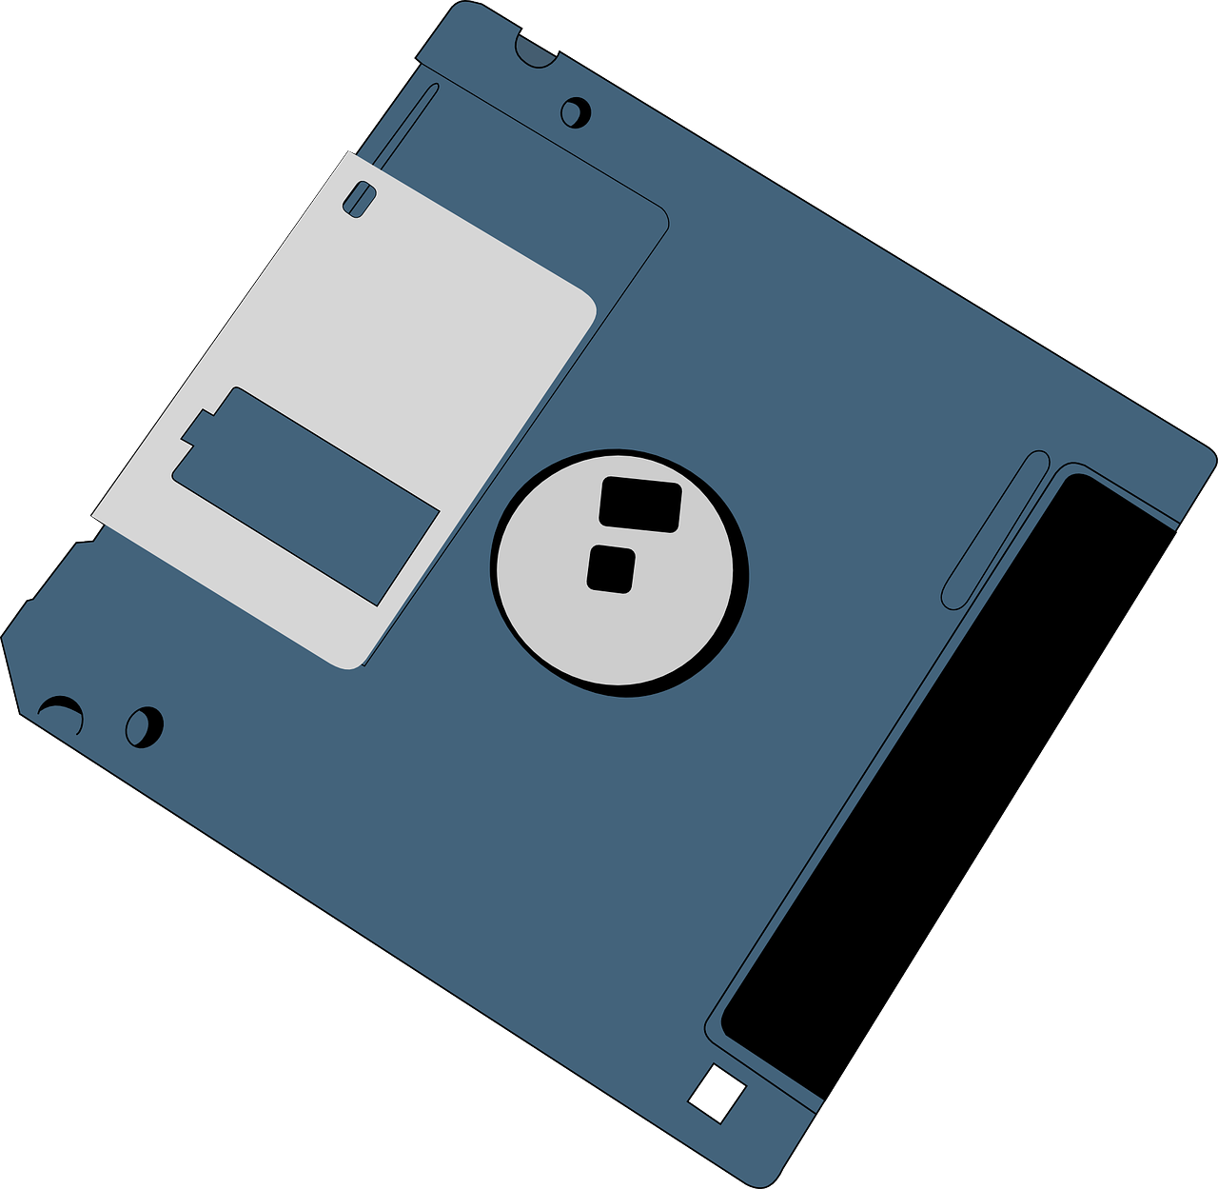
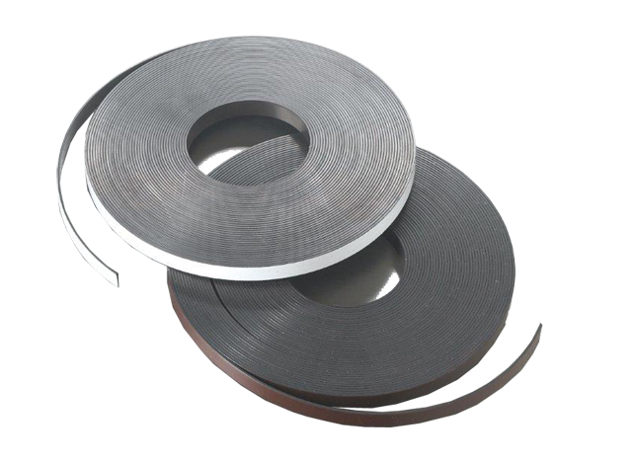
TOPIC 2.1.5 – SECONDARY MEMORY
SECONDARY MEMORY MEDIA
Other methods
USB Flash Drive
Secure Digital (SD) or Compact Flash (CF) Card
Floppy Disk
Magnetic Tape
These are usually used as external, removable storage, but machines can use them as main secondary storage
EMMC computers use what are effectively SD cards as storage

Slide 13

TOPIC 2.1.5 – SECONDARY MEMORY
Secondary storage at scale
Large amounts of secondary storage drives are compiled together to make data centers, storing user accounts and information for services we all use

Slide 14
TOPIC 2.1.5 – SECONDARY MEMORY
non-volatile?
It is of course important to note that no memory is truly non-volatile
Why might this be?
What are some consequences if precautions aren’t taken against this?

Slide 15
TOPIC 2.1.5 – SECONDARY MEMORY
Cost
Additionally, keeping and maintaining all of this data has a cost
Replacing hardware, powering systems, and paying the people to do these things, will lead the cost of data storage to only rise

Slide 16

TOPIC 2.0 – computer organization
Vocab to remember
Primary Storage
Secondary Storage
Volatile Memory
Non-volatile Memory
Virtual Memory
HDD
SSD

